Slide 1
The democratic structure of the BVA Gymnasium Dormagen/the school’s council

Slide 2
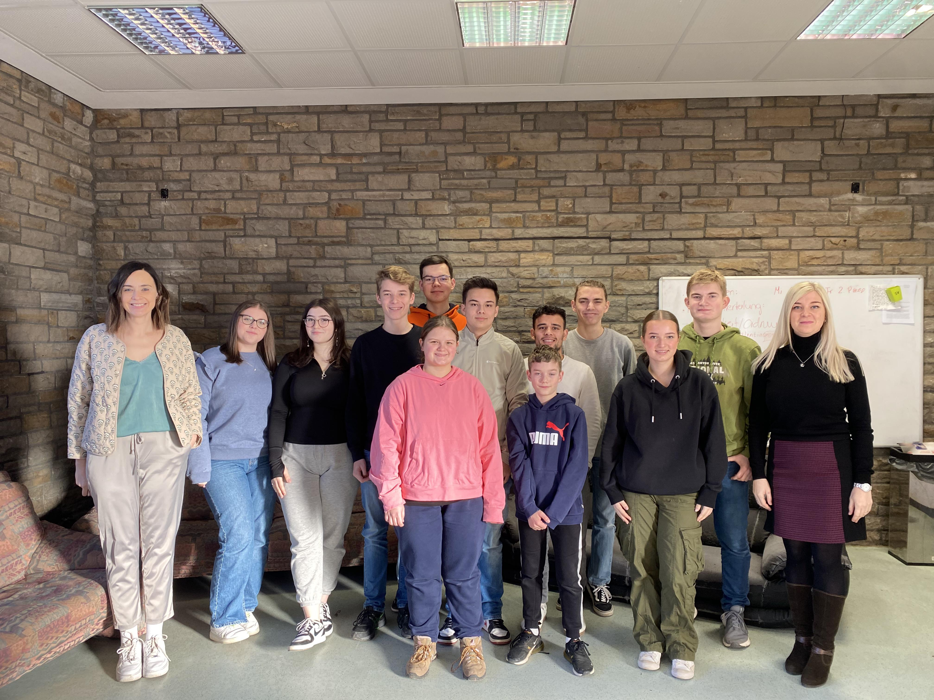
This is the BVA student council:
It consists of 12 students
Which are elected once a year
There are 2 consulting teachers
Our meetings are twice a week on Wednesday and Friday
The meetings change with upcoming class calendar changes
The democratic structure of the BVA Gymnasium Dormagen/the school’s council

Slide 3
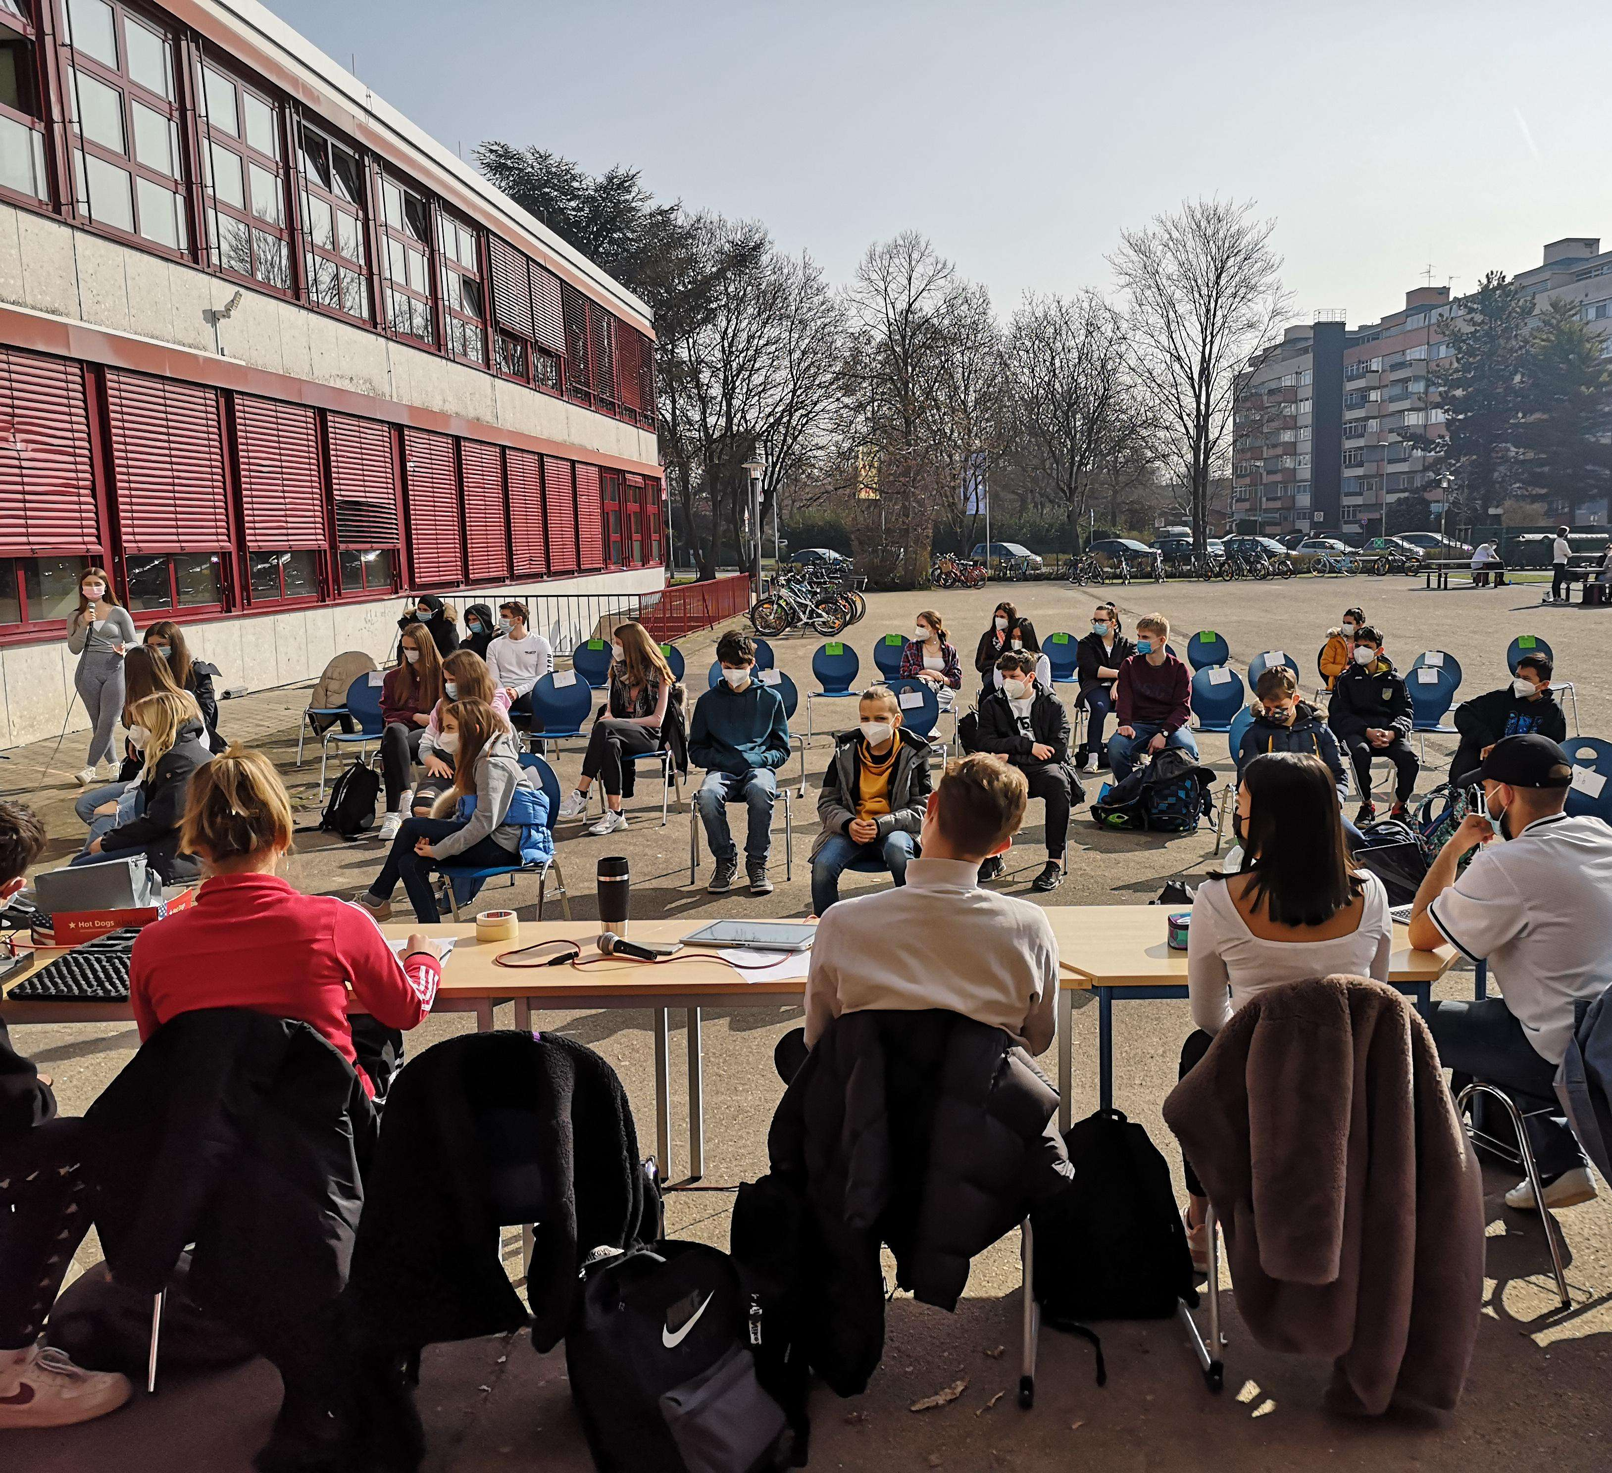
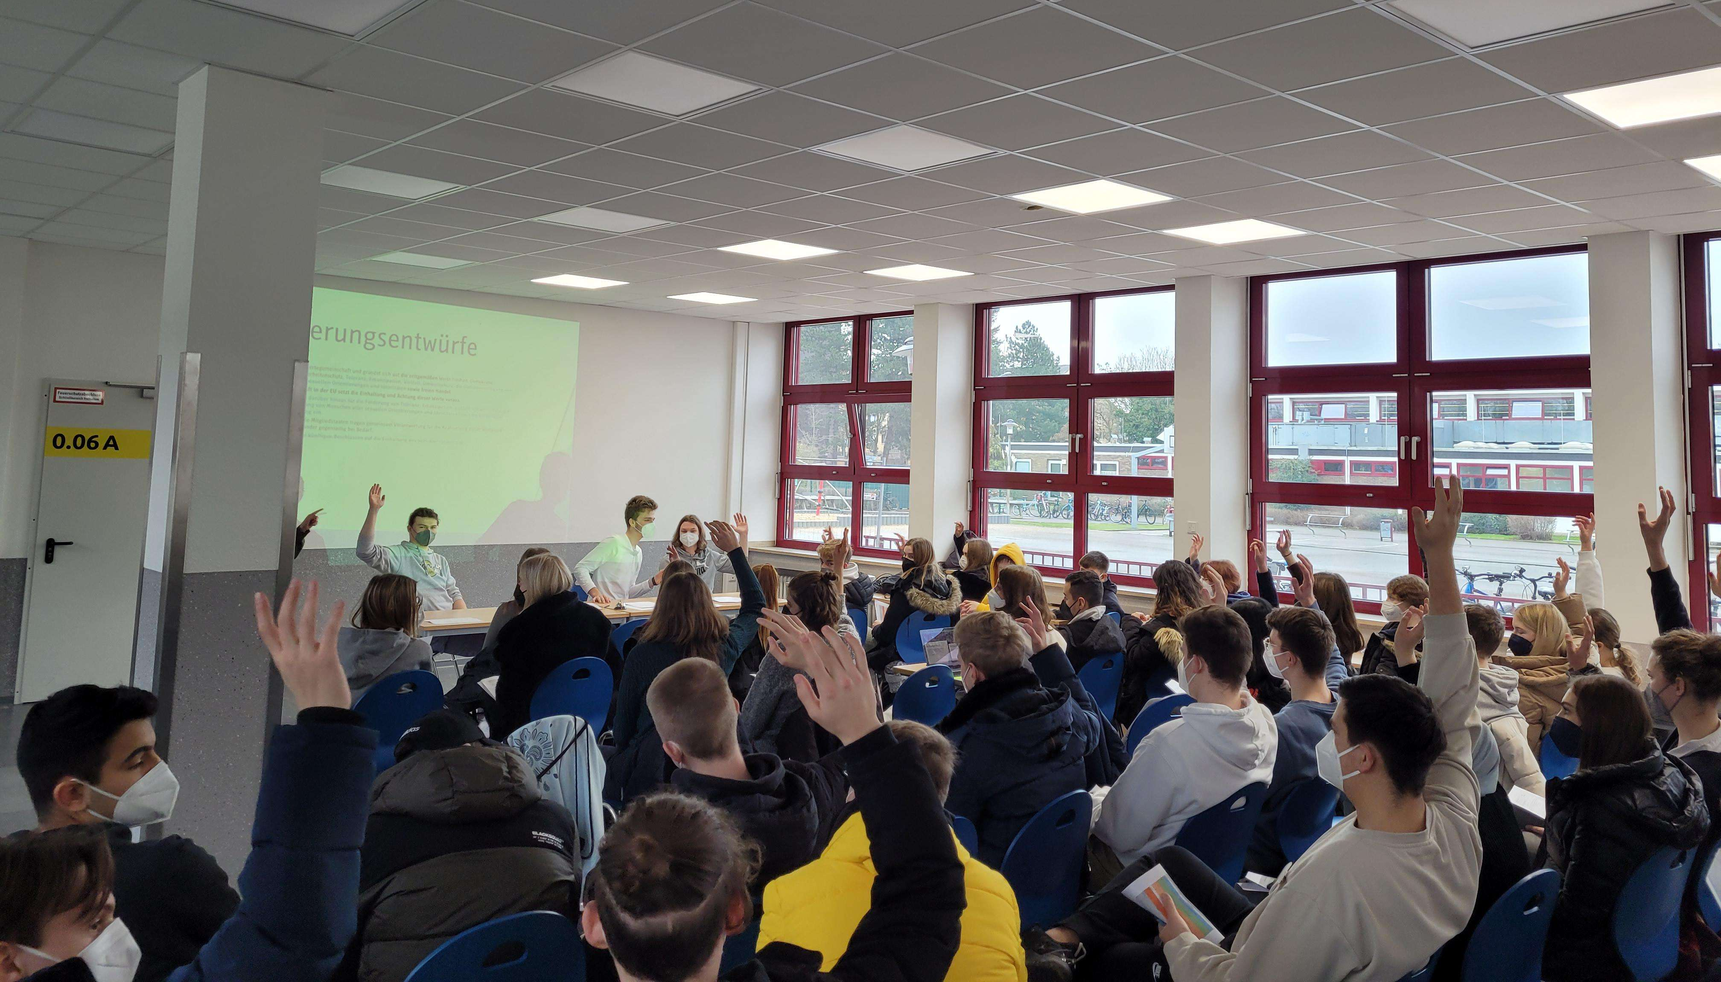
Two general school assemblies a year:
Every tutor group sends a representative.
The student council informs about its activities.
Then, students can share their ideas and wishes.
The student council is elected once a year during the general assembly.
This is the BVA student council:
It consists of 12 students
Which are elected once a year
There are 2 consulting teachers
Our meetings are twice a week on Wednesday and Friday
The meetings change with upcoming class calendar changes
The democratic structure of the BVA Gymnasium Dormagen/the school’s council

Slide 4
Two general school assemblies a year:
Every tutor group sends a representative.
The student council informs about its activities.
Then, students can share their ideas and wishes.
The student council is elected once a year during the general assembly.
The student council – overall information
Consists of 12 students and 2 consulting teachers – elected democratically once a school year.
The objective is the connection between students and teachers, parents, the principal and the city council.
Meets twice a week for student meetings.
Is responsible for fulfilling the students‘ ideas and wishes regarding the school by:
implementing various projects like an outside classroom or drinking fountains.
raising money through a sponsored walk for charity and for our school.
enhancing knowledge in seminars and through international exchange.
This is the BVA student council:
It consists of 12 students
Which are elected once a year
There are 2 consulting teachers
Our meetings are twice a week on Wednesday and Friday
The meetings change with upcoming class calendar changes

Slide 5
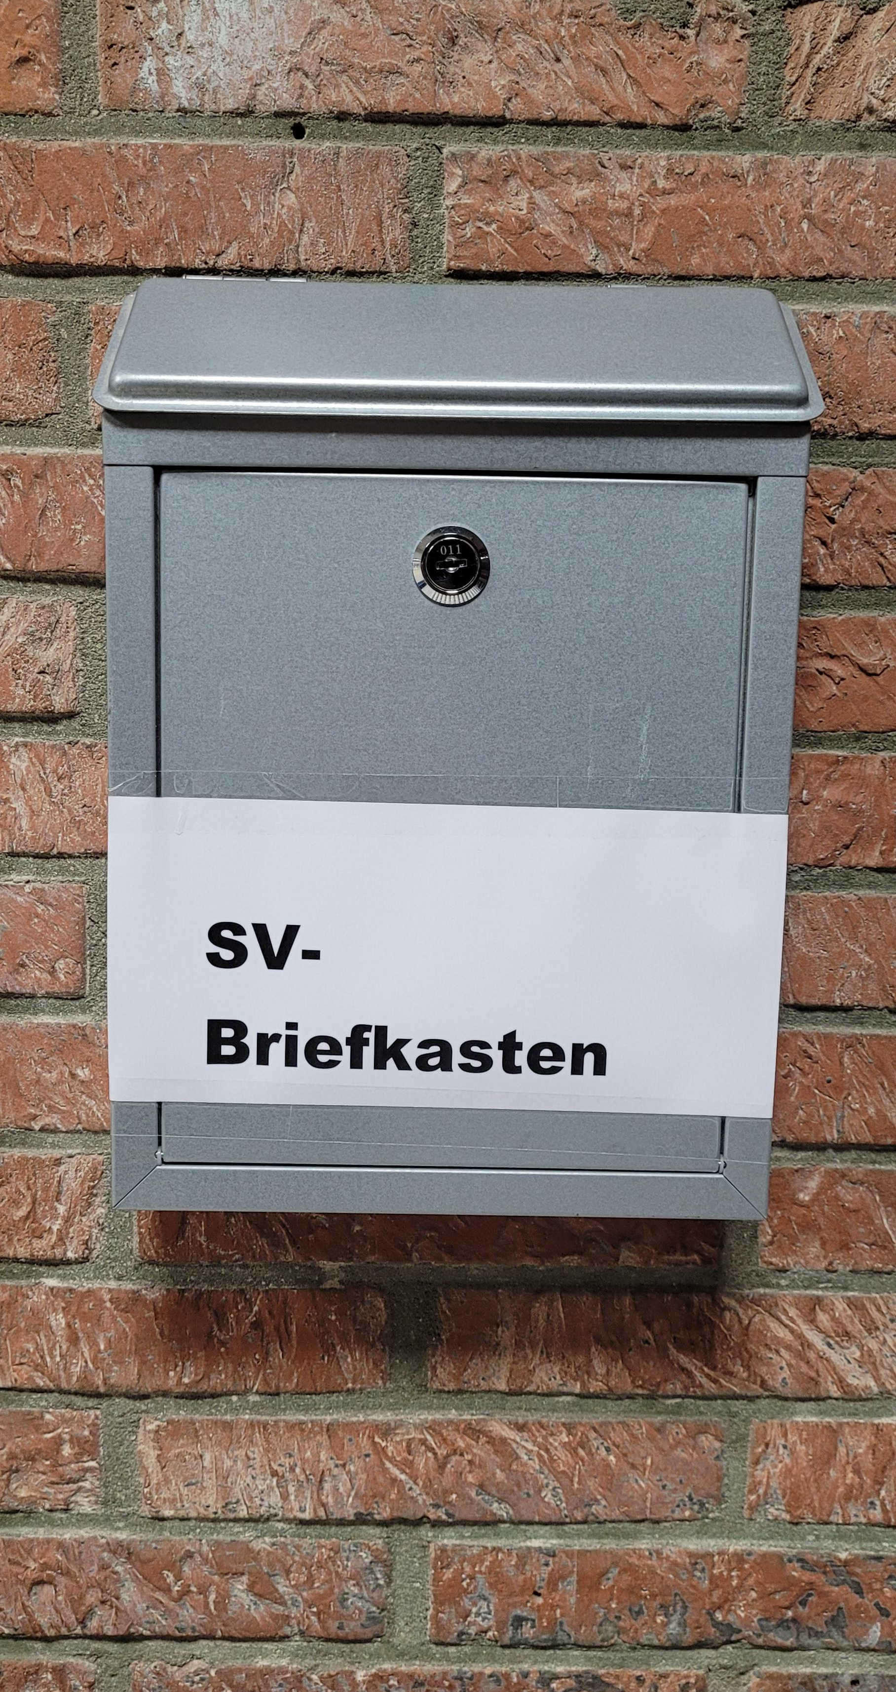
The student council – overall information
Our school’s democratic structure
Every tutor group has two representatives:
usually, a girl and a boy,
In the senior years (years 10-13) there are no tutor groups, but courses, so every senior year has 4-6 representatives.
All the representatives can send messages to the student council via our school messenger or using the special mailbox.
Two general school assemblies a year:
Every tutor group sends a representative.
The student council informs about its activities.
Then, students can share their ideas and wishes.
The student council is elected once a year during the general assembly.
Consists of 12 students and 2 consulting teachers – elected democratically once a school year.
The objective is the connection between students and teachers, parents, the principal and the city council.
Meets twice a week for student meetings.
Is responsible for fulfilling the students‘ ideas and wishes regarding the school by:
implementing various projects like an outside classroom or drinking fountains.
raising money through a sponsored walk for charity and for our school.
enhancing knowledge in seminars and through international exchange.

Slide 6
Our school’s democratic structure
Every tutor group has two representatives:
usually, a girl and a boy,
In the senior years (years 10-13) there are no tutor groups, but courses, so every senior year has 4-6 representatives.
All the representatives can send messages to the student council via our school messenger or using the special mailbox.

Slide 7
Our school’s democratic structure
School assemblies with the headmaster/teachers /parents
The school conference takes place twice a school year:
To ensure democracy in our school:
6 students, some parents, 6 teachers and the headmaster meet.
They have productive discussions about school life, make important decisions and ensure that everyone is informed.
The students' opinion always comes first for the student council, and they represent the students by voting during every important decision.
There are general assemblies of all the representatives and the student council: twice a year - usually in August and in January.
The parents also have a parents‘ council.
The councils work together with the headmaster to improve school life.
They also meet the mayor regularly.
Our pupils from year 5&6 take part in the children‘s parliament of Dormagen.
Additionally, students in year 5 have class meetings every month, a social worker helps to organize them (German word: Klassenrat).

Slide 8
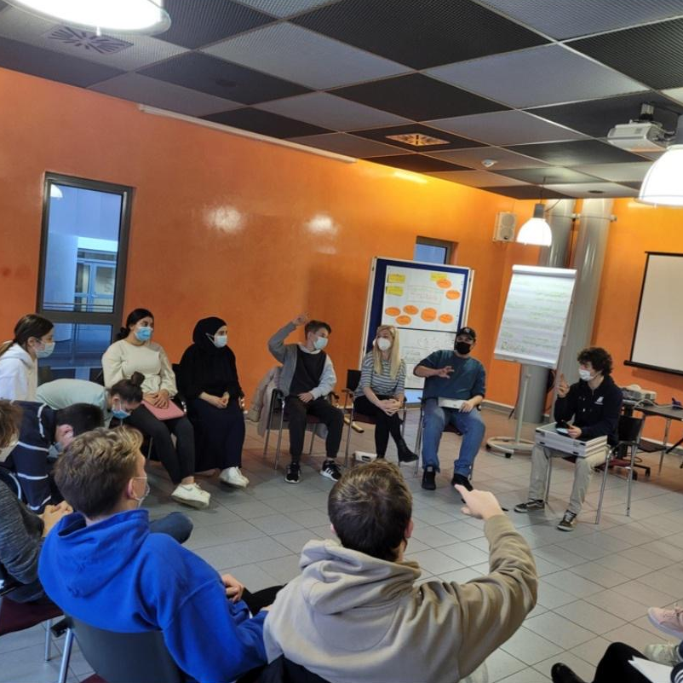
School assemblies with the headmaster/teachers /parents
The student council seminar
Every year in Cologne
The school conference takes place twice a school year:
To ensure democracy in our school:
6 students, some parents, 6 teachers and the headmaster meet.
They have productive discussions about school life, make important decisions and ensure that everyone is informed.
The students' opinion always comes first for the student council, and they represent the students by voting during every important decision.
To connect the newly elected members of the student council
To learn more about the tasks and various projects
Gaining new ideas and brainstorming
Trying out new strategies to socialize further

Slide 9
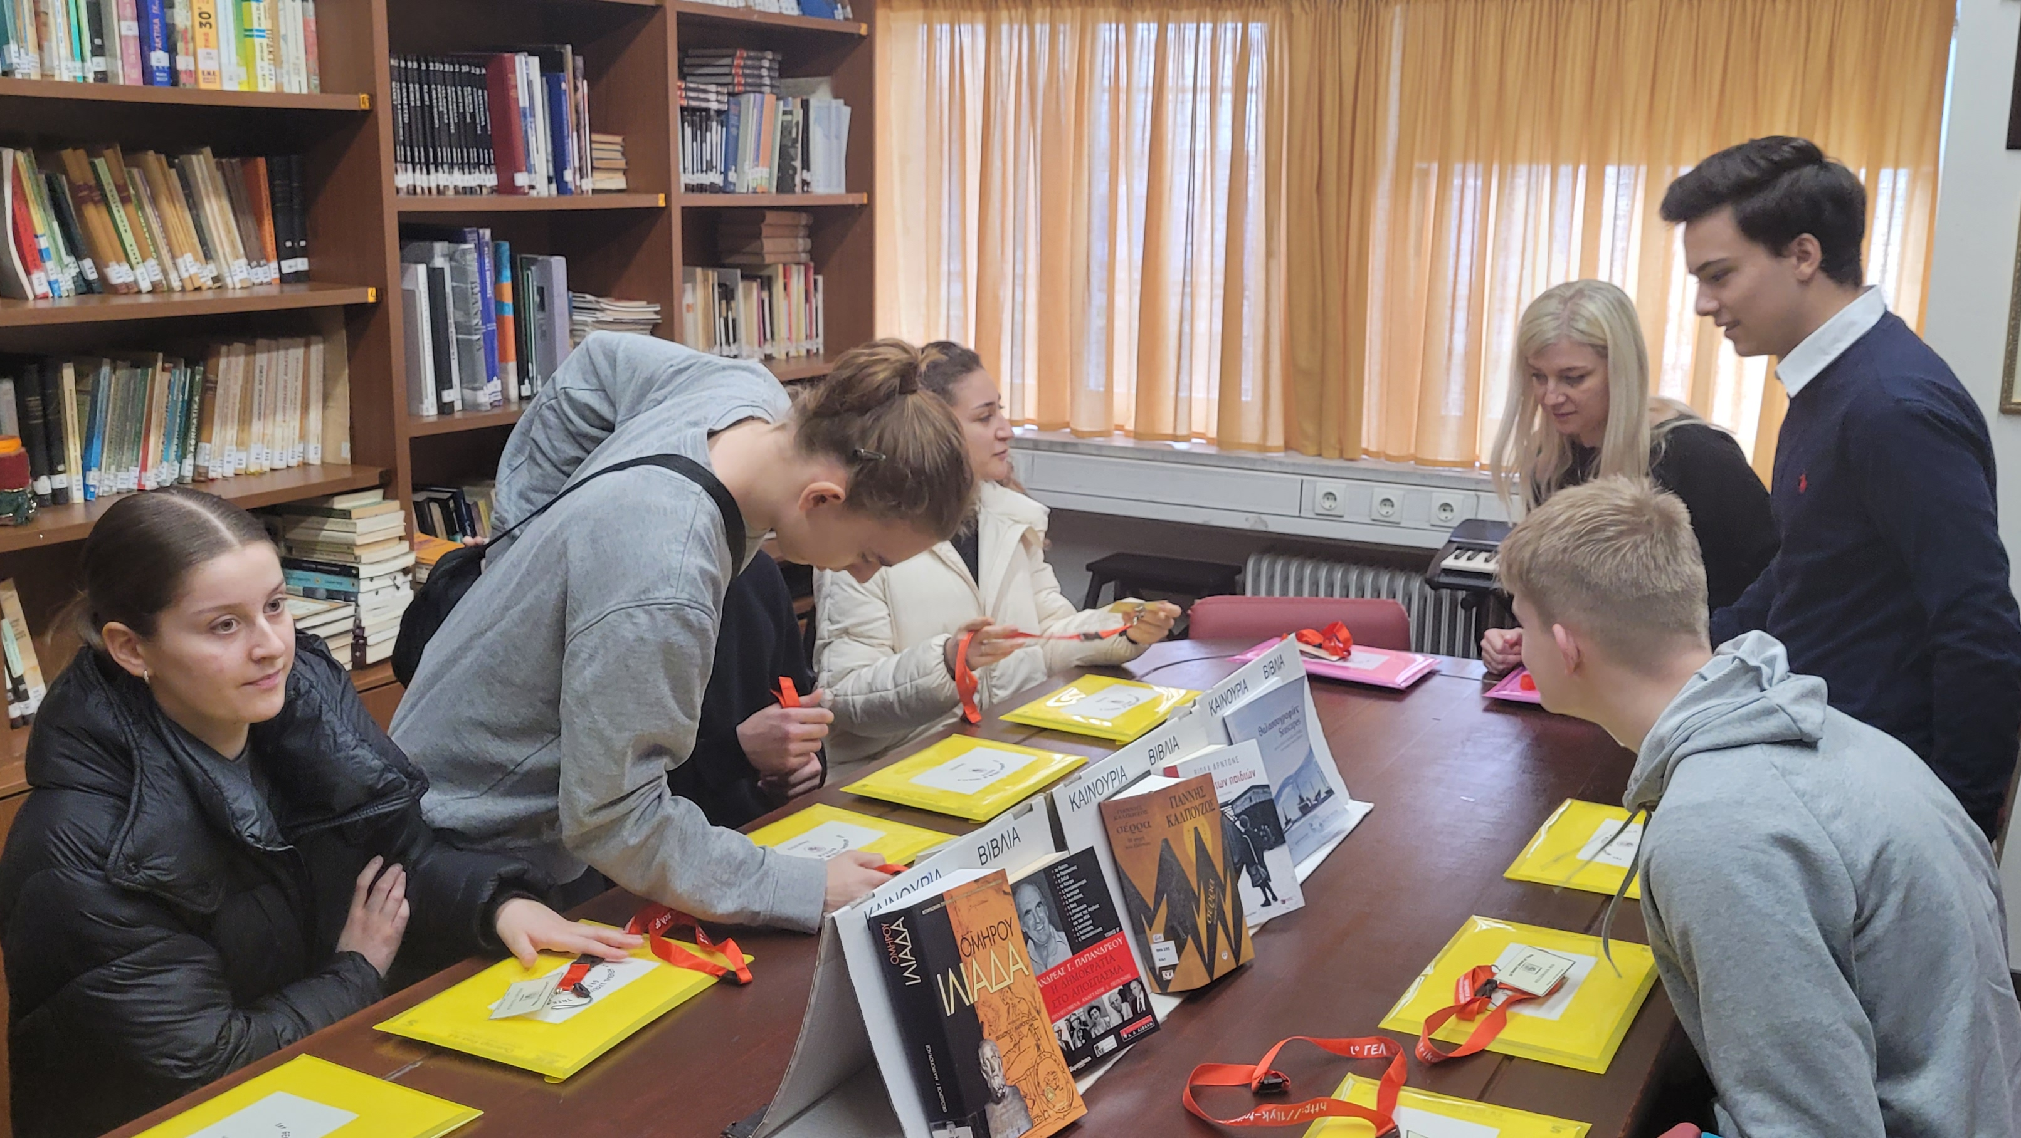
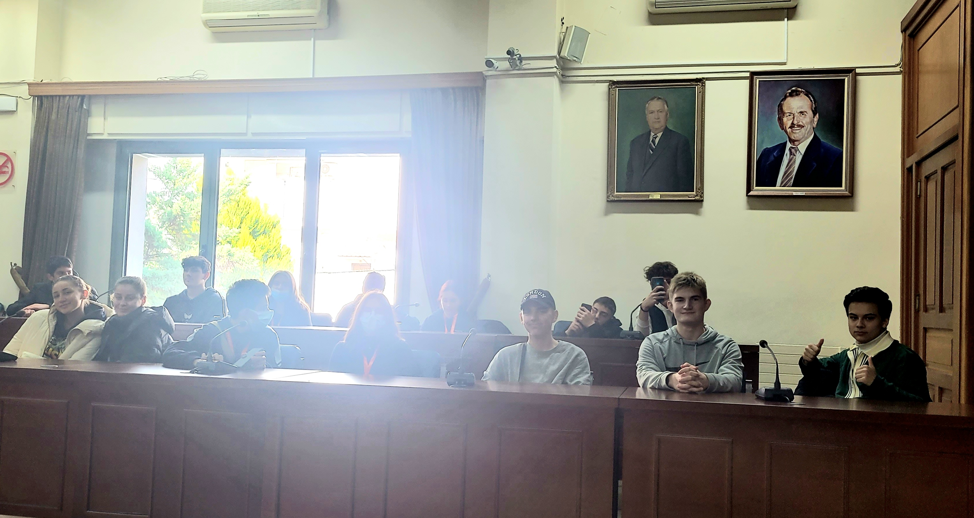
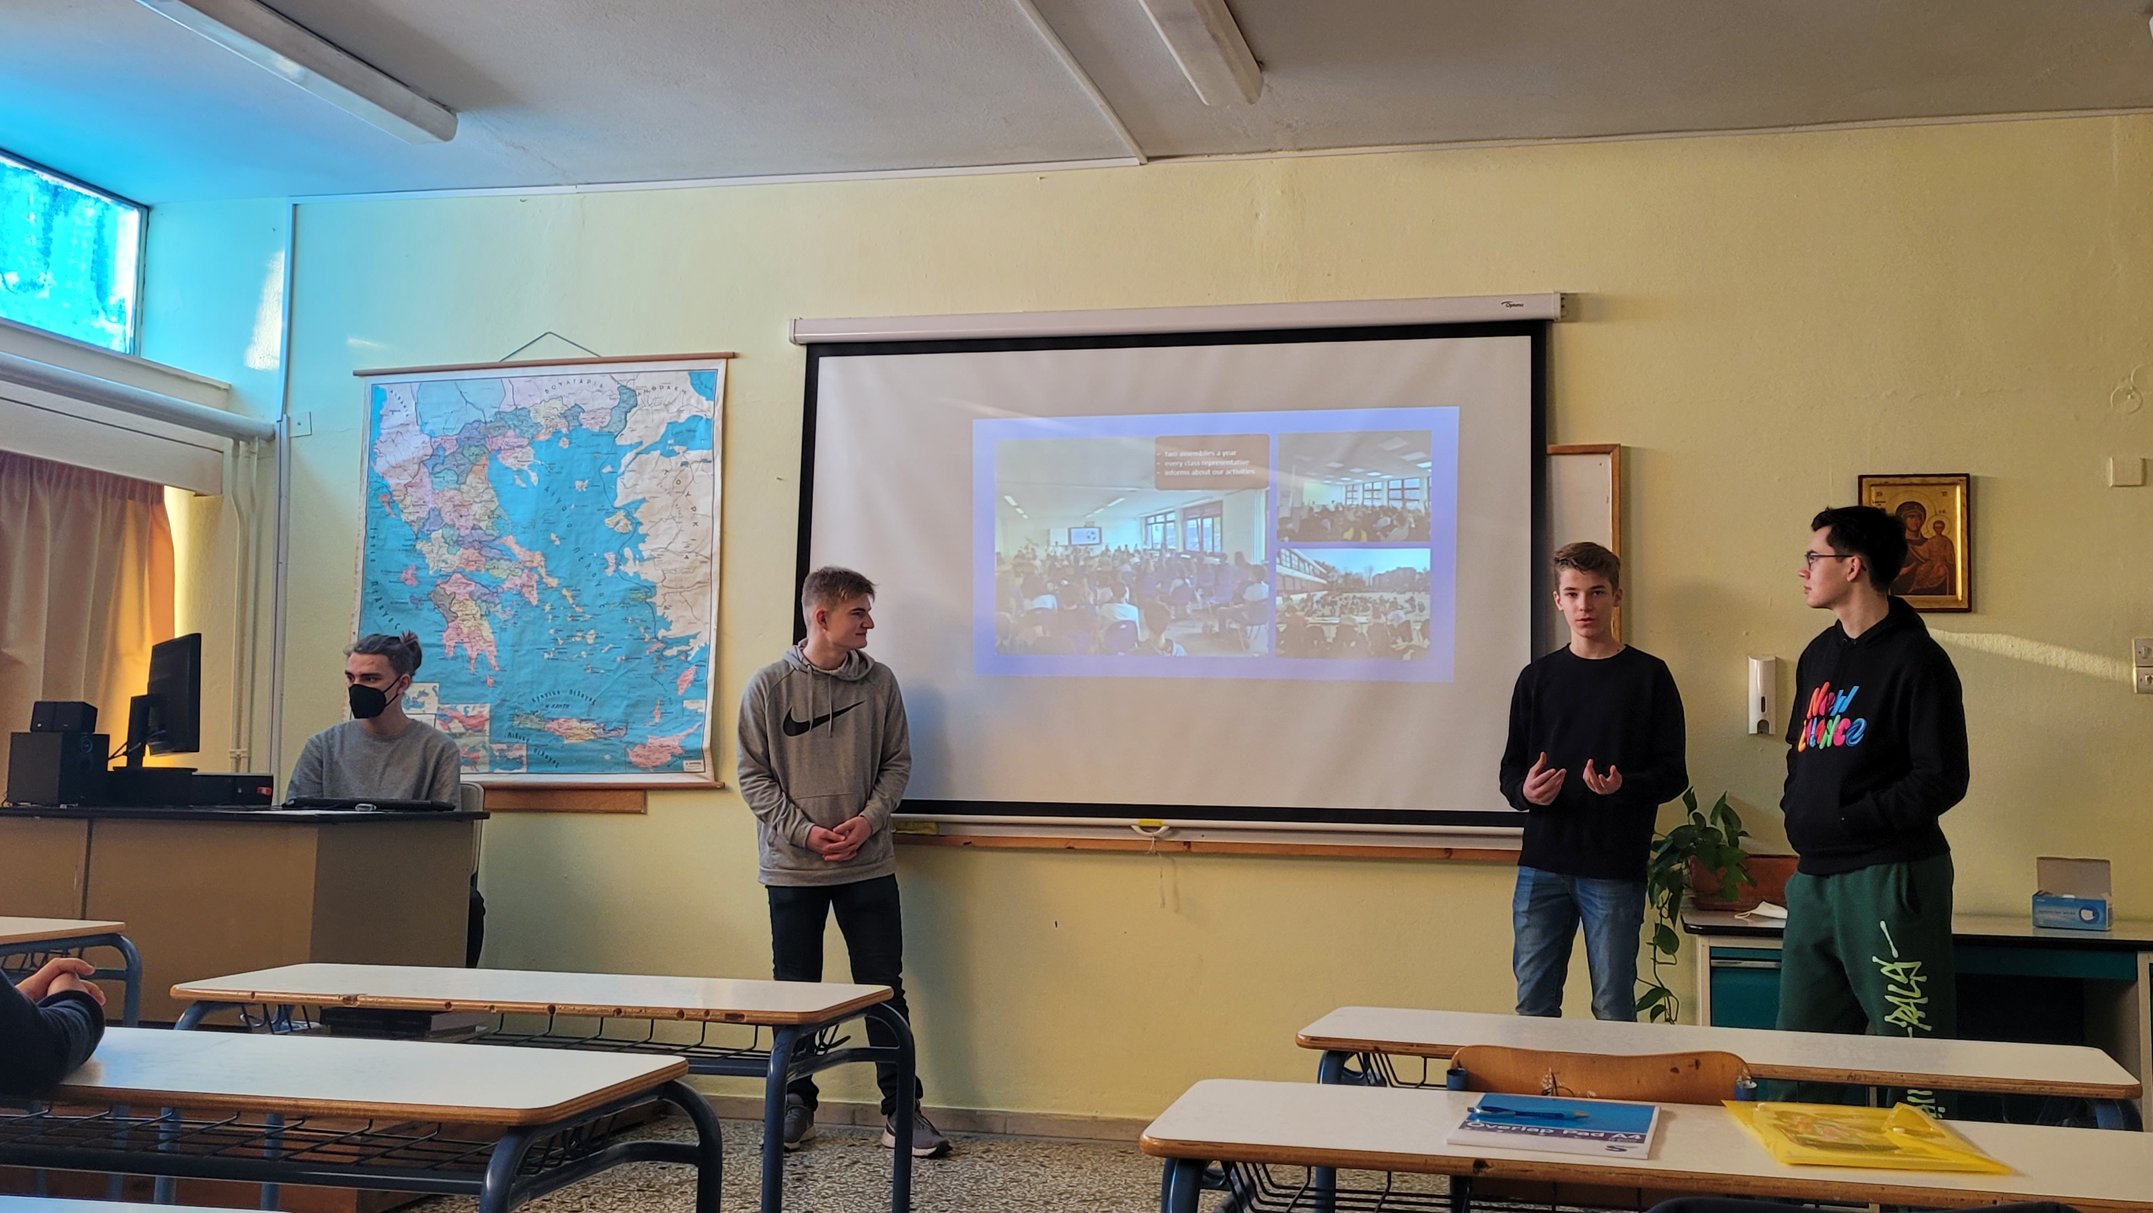
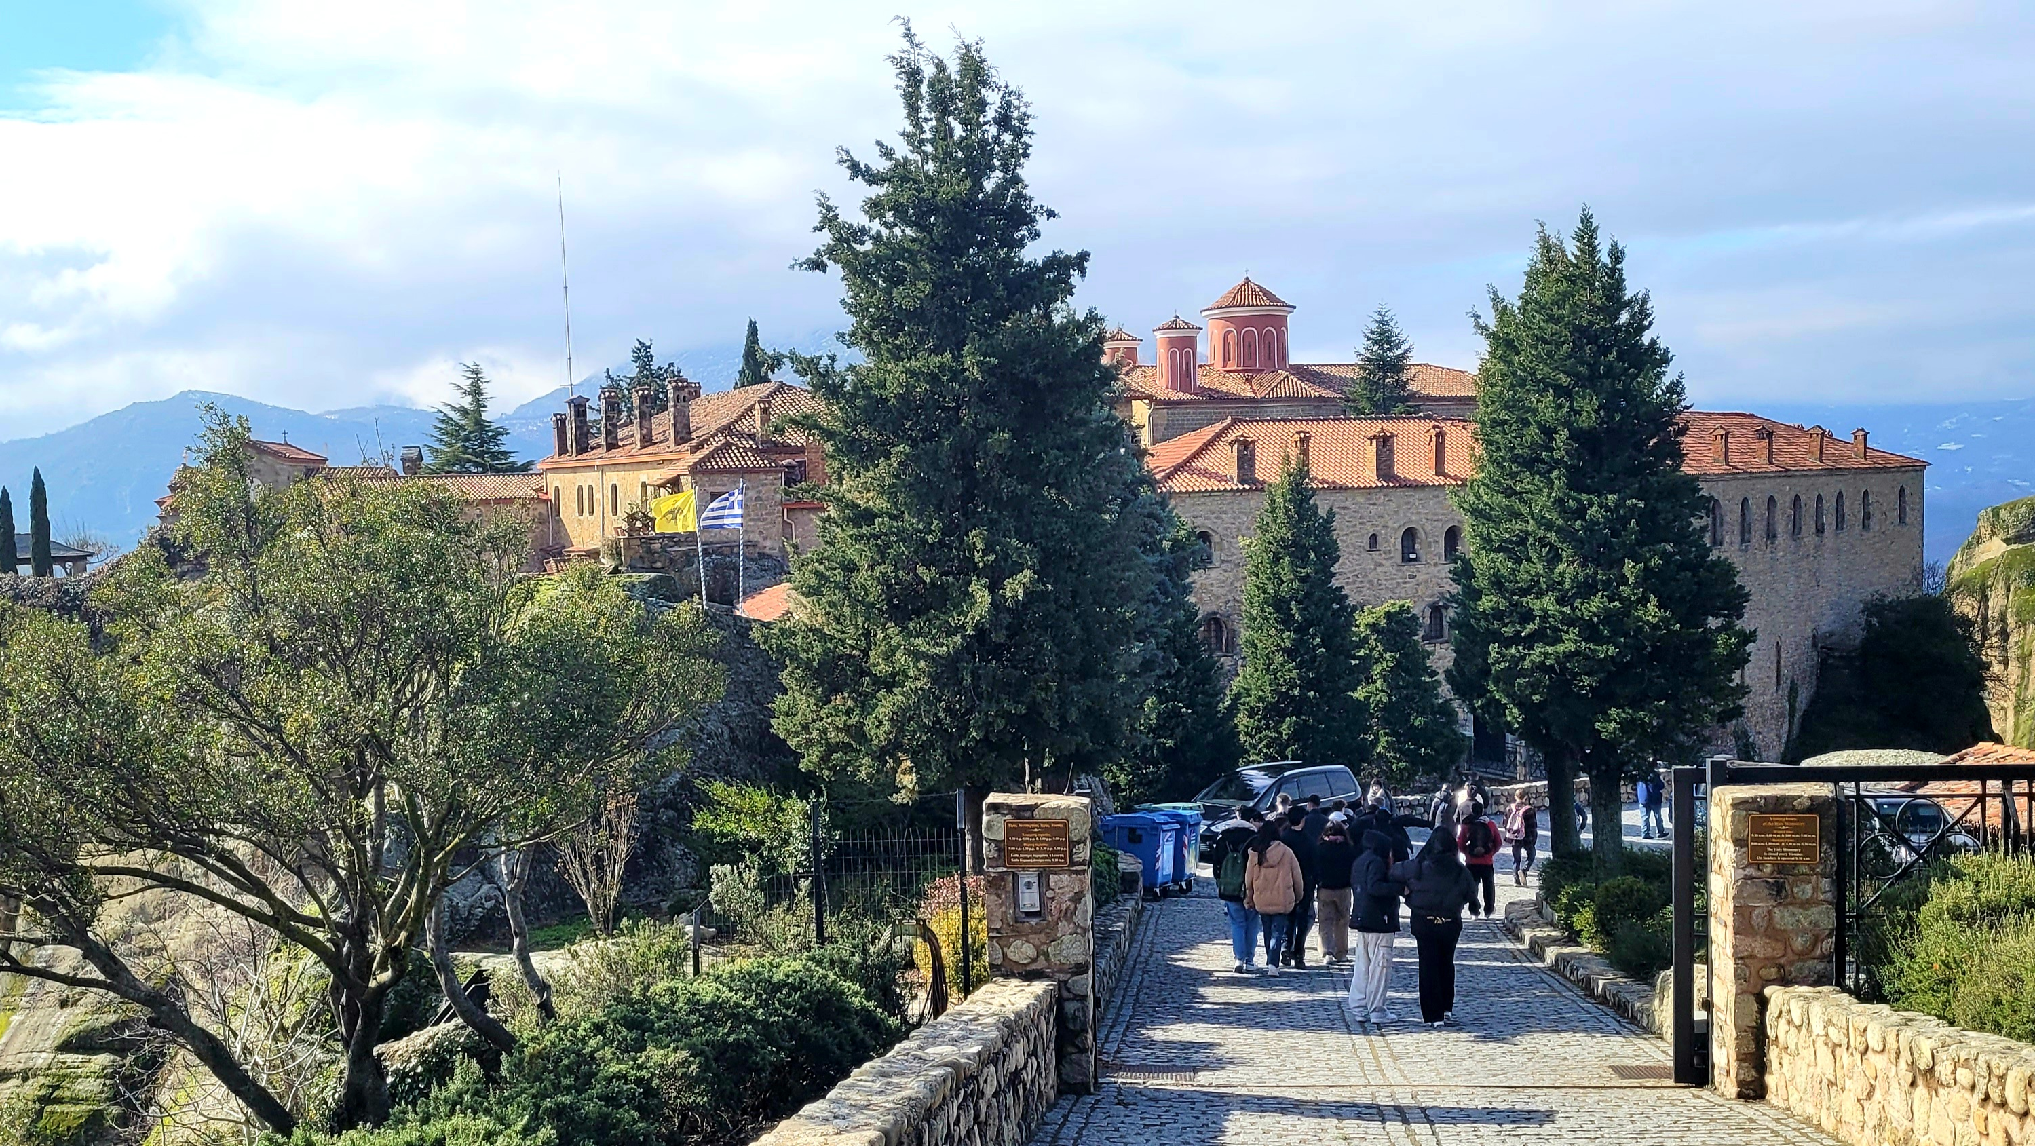
The student council seminar
International exchange 2023
We went to Greece to find more ideas to improve promoting democracy at our school: school exchange with a school in Trikala, central Greece
Every year in Cologne
To connect the newly elected members of the student council
To learn more about the tasks and various projects
Gaining new ideas and brainstorming
Trying out new strategies to socialize further
School assemblies with the headmaster/teachers /parents
The school conference takes place twice a school year:
To ensure democracy in our school:
6 students, some parents, 6 teachers and the headmaster meet.
They have productive discussions about school life, make important decisions and ensure that everyone is informed.
The students' opinion always comes first for the student council, and they represent the students by voting during every important decision.

Slide 10
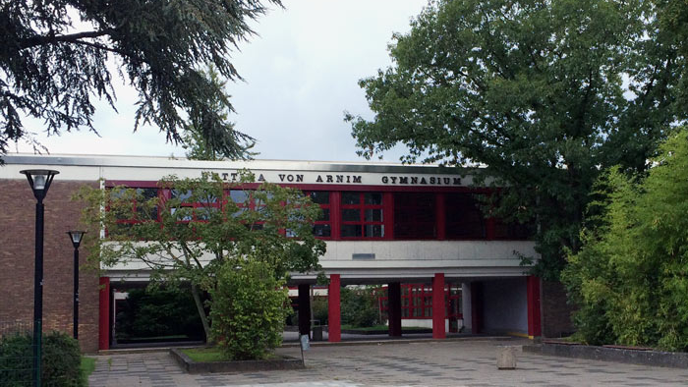
International exchange 2023
We went to Greece to find more ideas to improve promoting democracy at our school: school exchange with a school in Trikala, central Greece

Slide 11
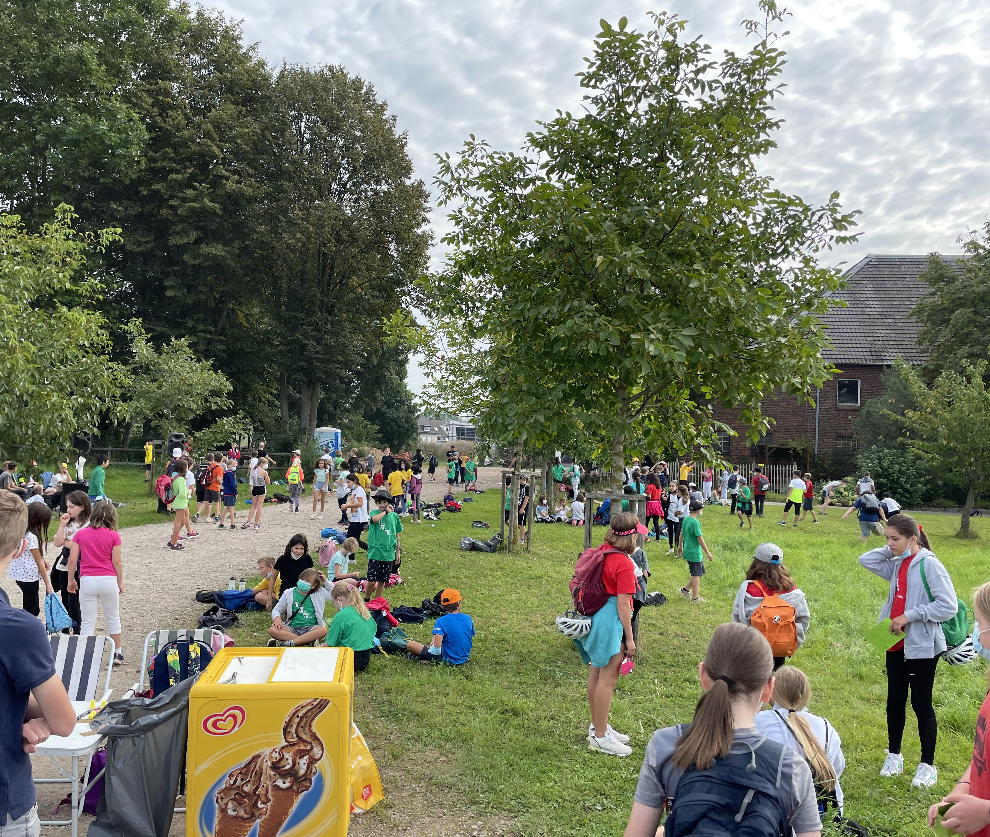
International exchange 2023
Sponsored Walk
A walk for charity
More than 15.000€ of revenue
Half of the money will be donated to charity:
2021: 9.000€ to a children’s organisation
1.000€ to Ukrainian refugees
2022: 7.500€ for a project of building fountains in poor countries to provide free and clean water.
We went to Greece to find more ideas to improve promoting democracy at our school: school exchange with a school in Trikala, central Greece

Slide 12
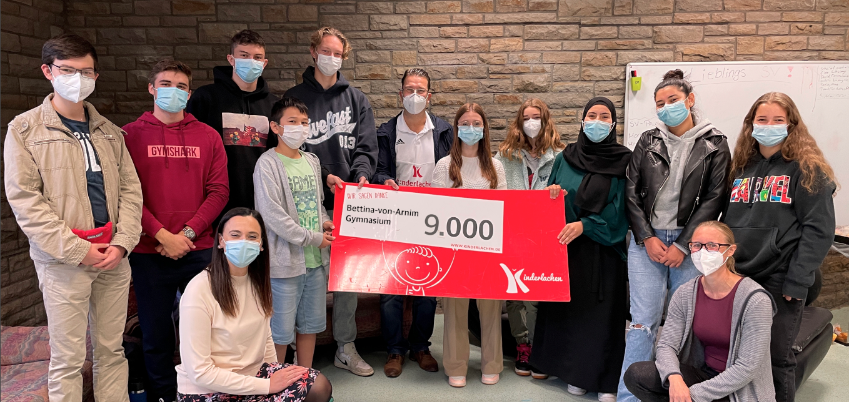
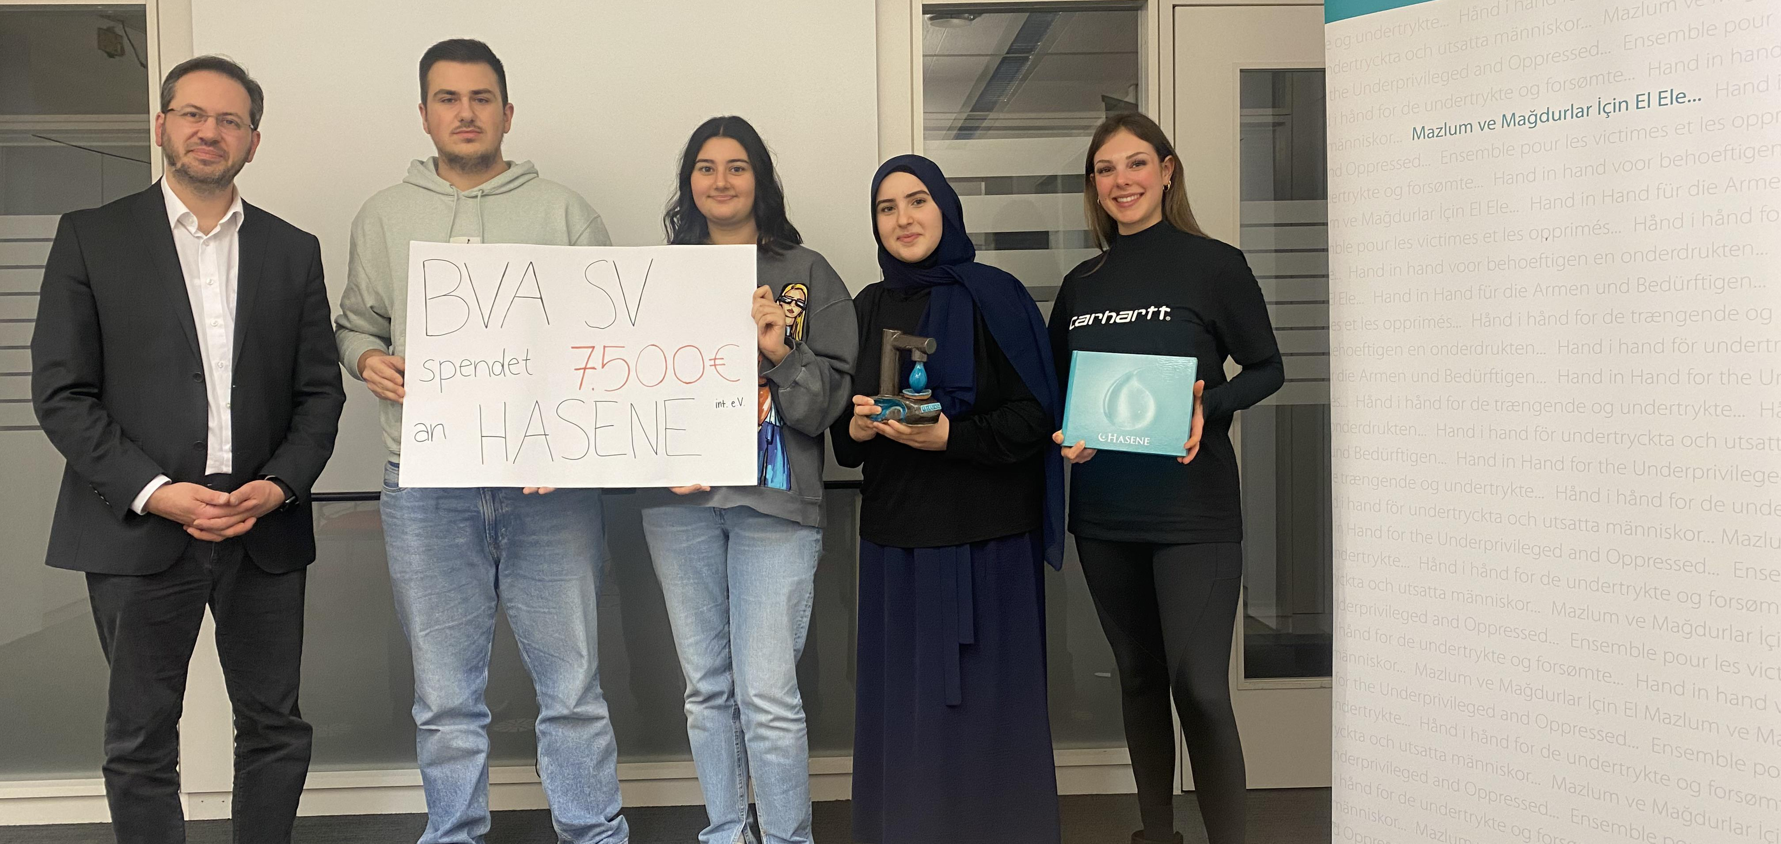
Sponsored Walk
9.000€ for children in need
A walk for charity
More than 15.000€ of revenue
Half of the money will be donated to charity:
2021: 9.000€ to a children’s organisation
1.000€ to Ukrainian refugees
2022: 7.500€ for a project of building fountains in poor countries to provide free and clean water.
7.500€ for fountains in Africa

Slide 13
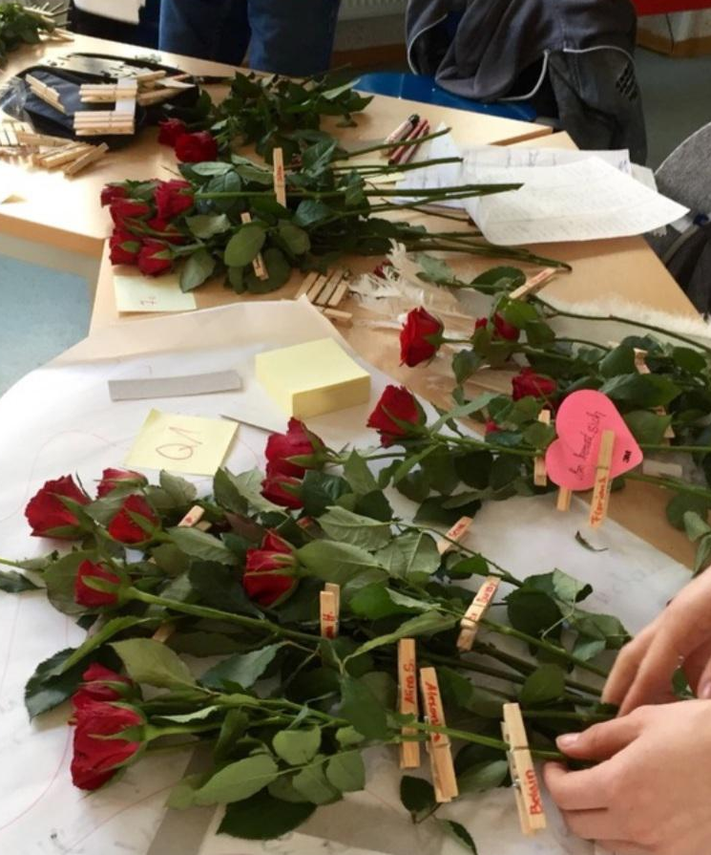
St. Valentine´s day
9.000€ for children in need
In the weeks leading up, students have the chance to buy roses for classmates.
They will be delivered to them either with the buyer‘s name or anonymously on St. Valentine‘s Day (14 February).
7.500€ for fountains in Africa

Slide 14
St. Valentine´s day
In the weeks leading up, students have the chance to buy roses for classmates.
They will be delivered to them either with the buyer‘s name or anonymously on St. Valentine‘s Day (14 February).

Slide 15
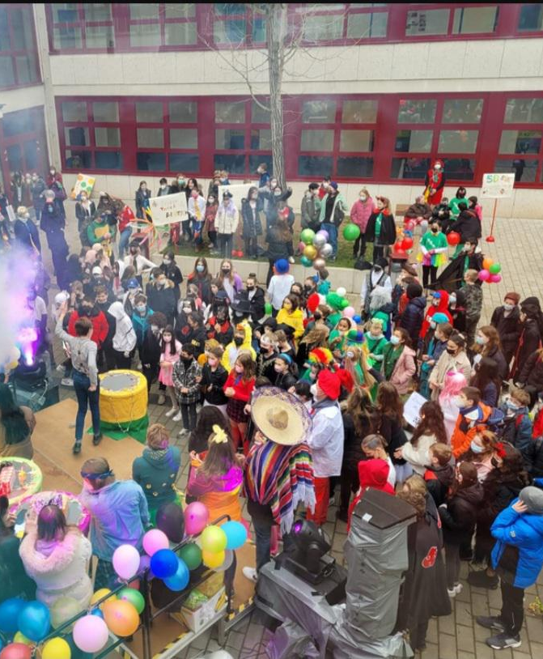
St. Nicholas Day and Easter Bunny event
For St. Nicholas Day we do the same, but with little Nicholases made out of chocolate – of course, it is fair trade!
At Easter we give the little chocolate bunnies as gifts.

Slide 16
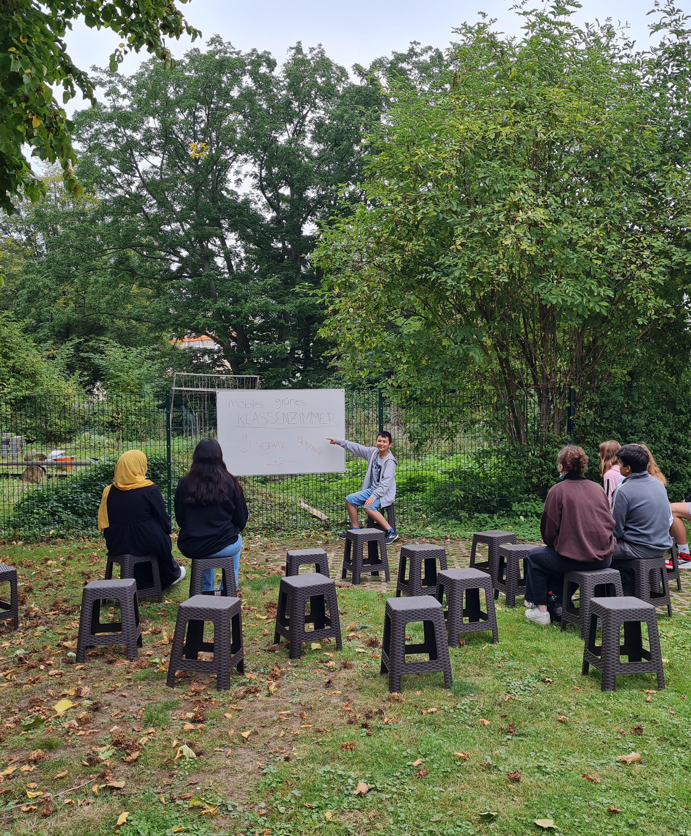
Carnival
The fifth and sixth grades have a carnival party with music, fun, and candy.
The student council helps to organise and presents the show on stage.

Slide 17
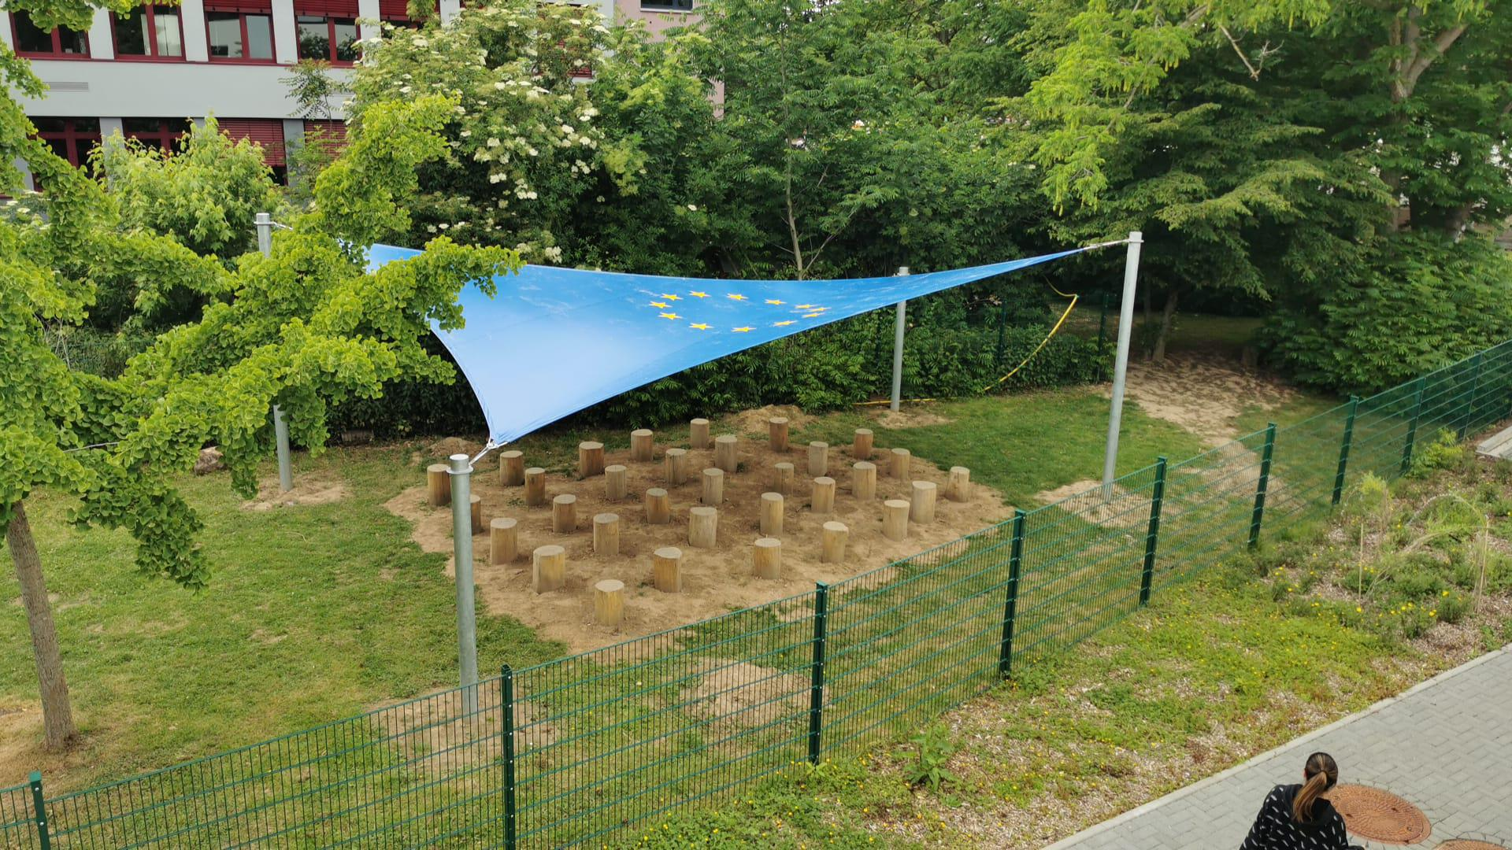
Special student council projects
Green classroom
A way to study outdoors in the shade:
The movable version: It is possible to bring chairs and a whiteboard to any place on the school territory.
The permanent version: Or one can have a class outside in our all-season outdoors room.

Slide 18
Special student council projects
Green classroom
A way to study outdoors in the shade:
The movable version: It is possible to bring chairs and a whiteboard to any place on the school territory.
The permanent version: Or one can have a class outside in our all-season outdoors room.

Slide 19
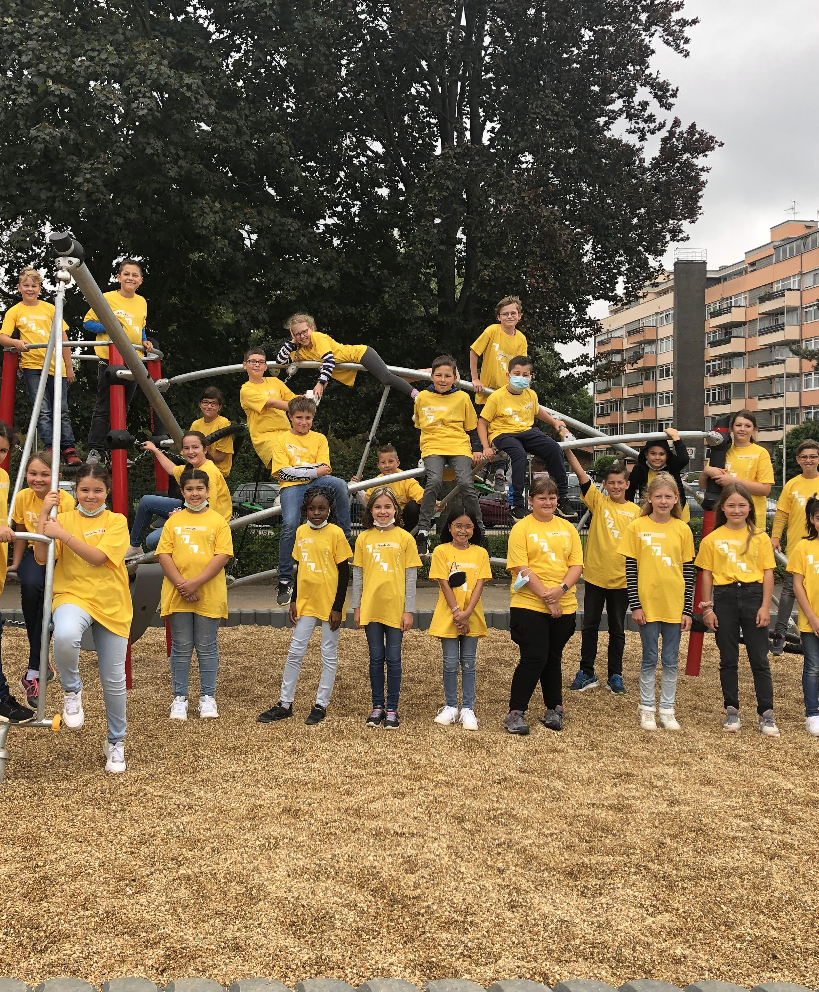
The climbing frame for our young students
This climbing frame has cost about 20.000€ and it has been financed by the parents‘ council and by the student council, which is a good example of the successful cooperation between the students and the parents.

Slide 20
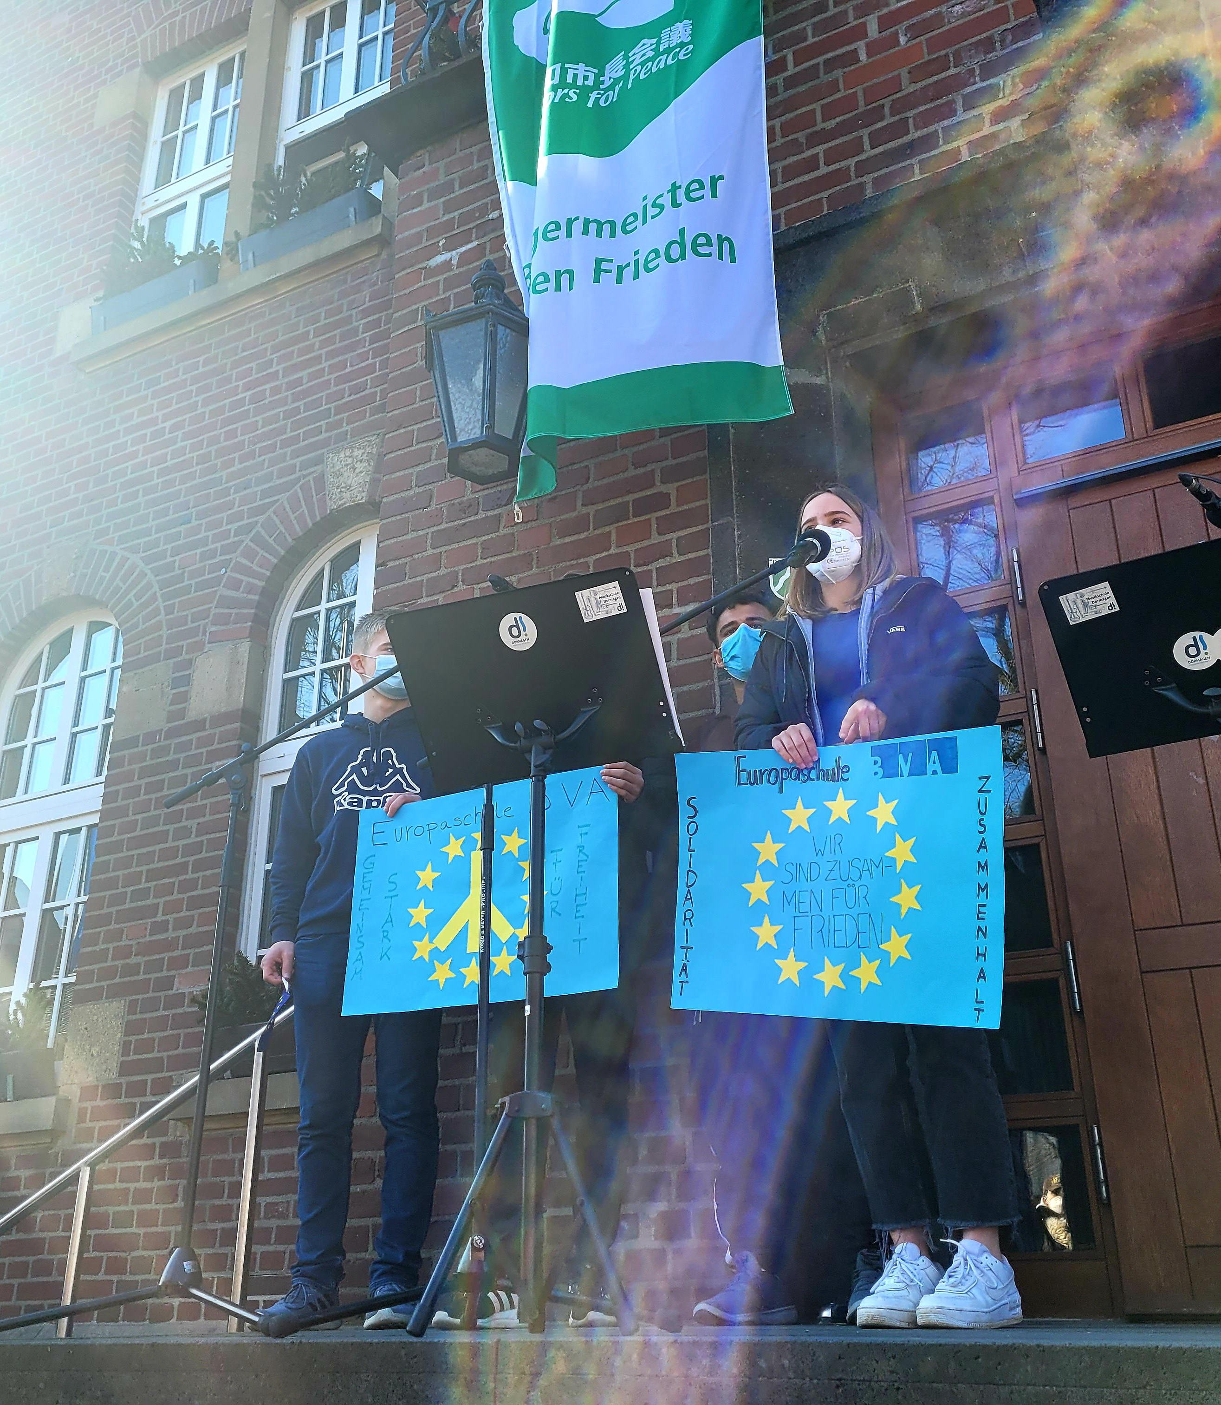
Demonstration for peace
We take part in demonstrations in our town Dormagen.
We stand for peace.
We have donated 1.000€ to help the Ukrainian people who fled from the war and are staying in Dormagen.

Slide 21
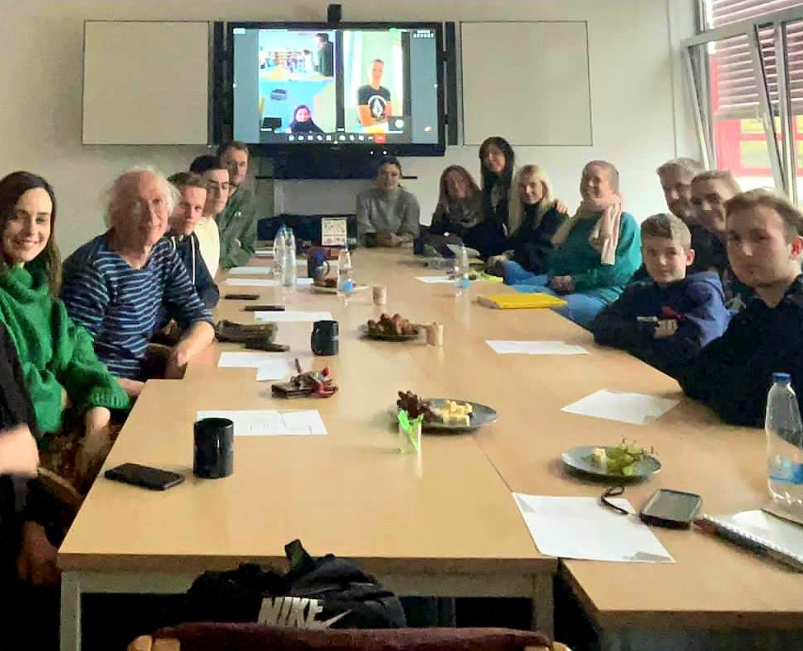
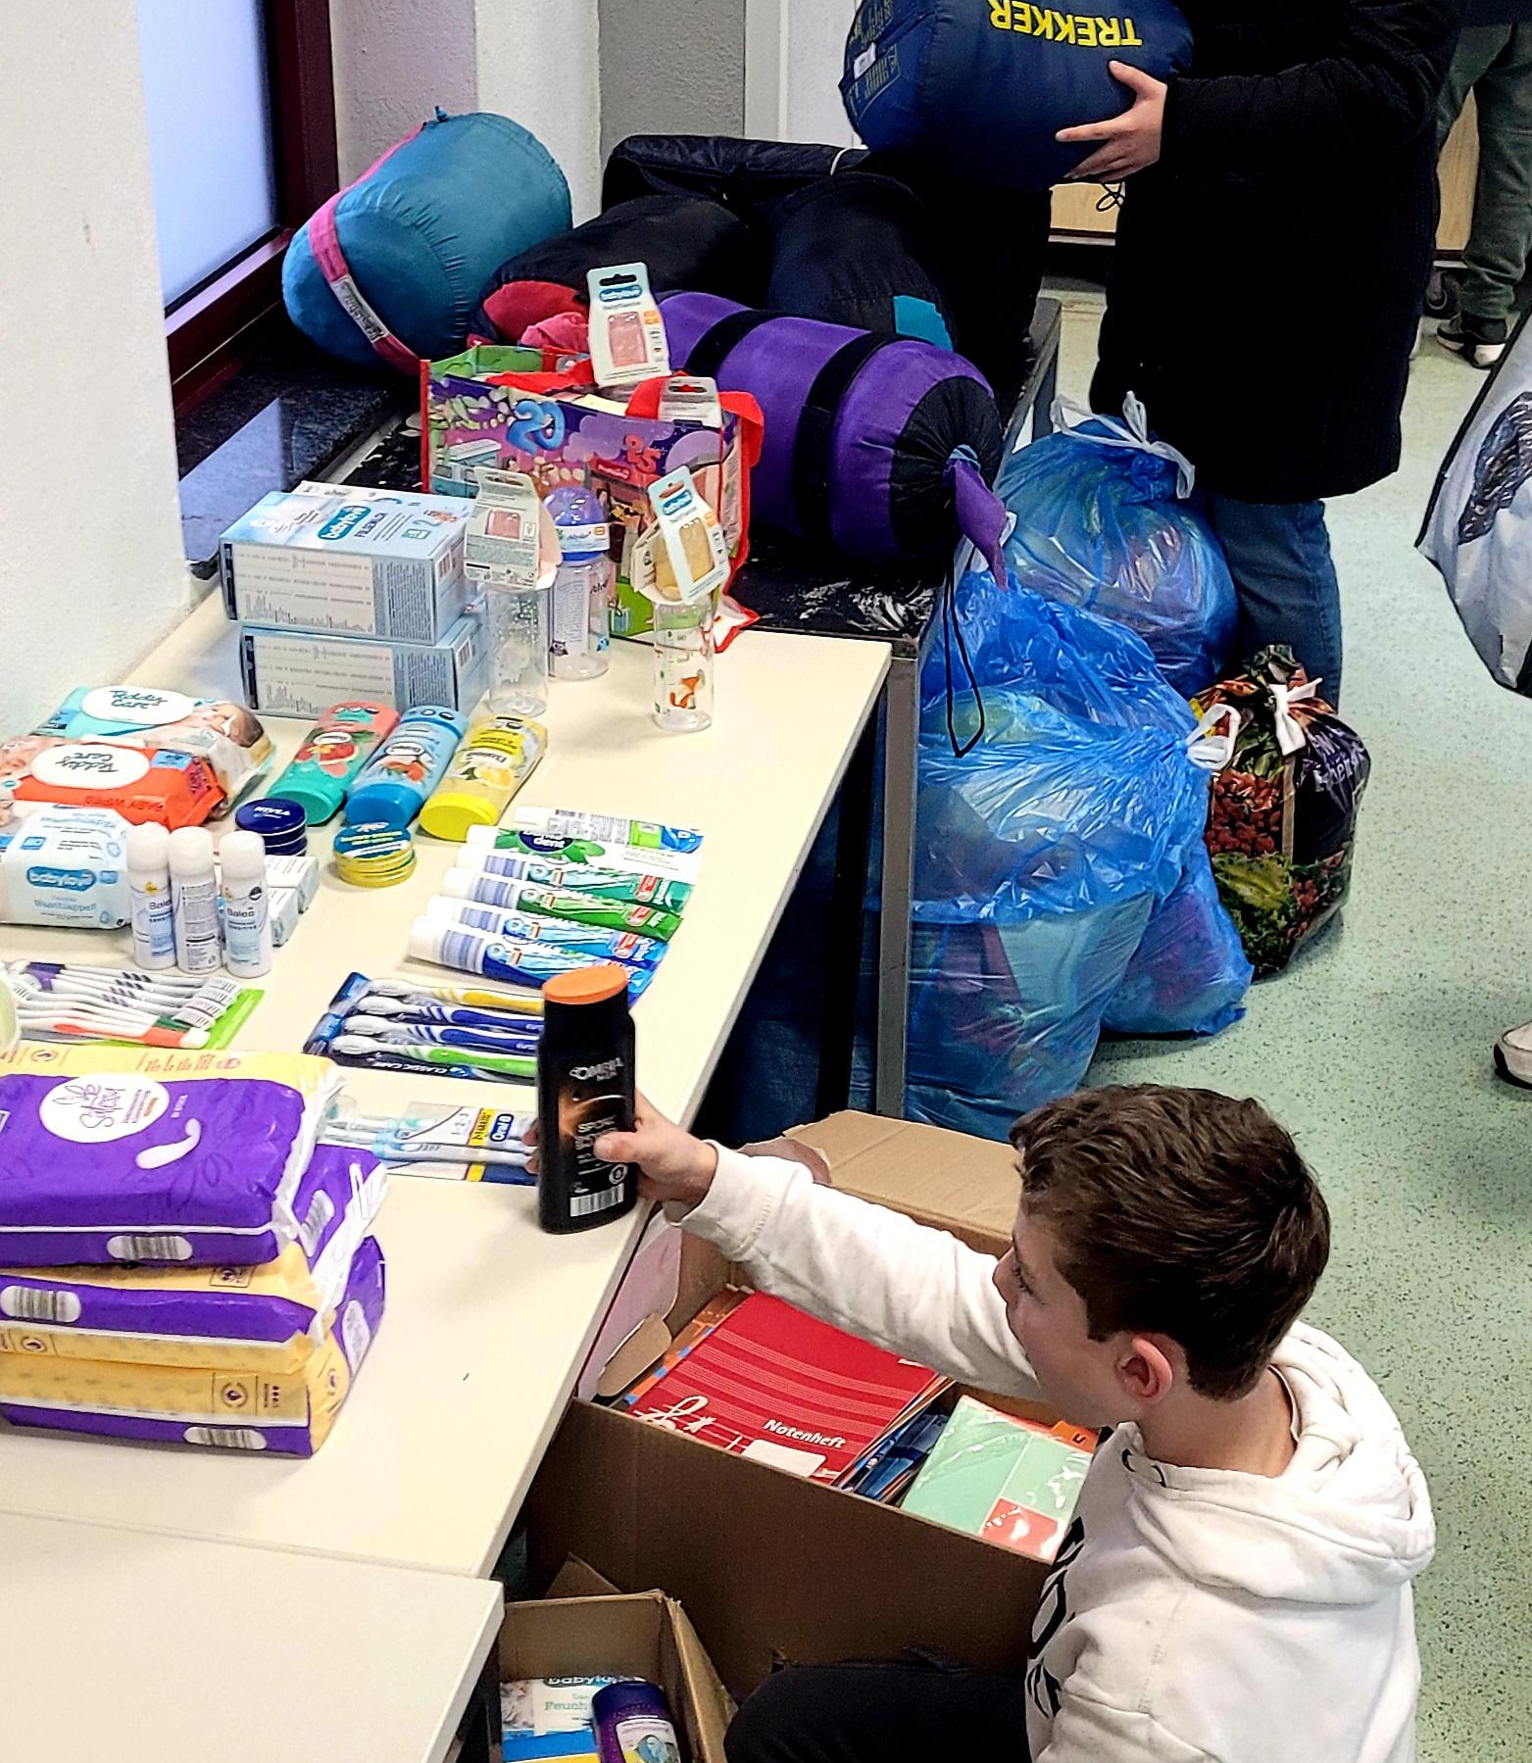
We help people in need!
We met up with local schools to organize activities to help the people in turkey in cause of the earthquakes,
We received a lot of donations for the people in need,
We were also saving a lot of money for them,
In future we will craft some easter decorations which we will sell on an easter market to also donate the money,

Slide 22
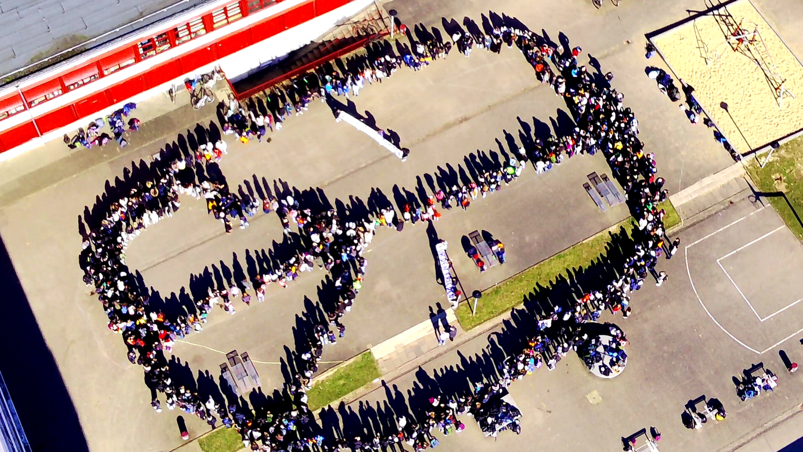
Coming soon…
Green schoolyards
More sponsored walks and other projects
Installing drinking fountains at school
Thank you for listening

Slide 23
This is the BVA student council:
It consists of 12 students
Which are elected once a year
There are 2 consulting teachers
Our meetings are twice a week on Wednesday and Friday
The meetings change with upcoming class calendar changes
Thank you for listening

